Slide 1

About the Presentations
The presentations cover the objectives found in the opening of each chapter.
All chapter objectives are listed in the beginning of each presentation.
You may customize the presentations to fit your class needs.
Some figures from the chapters are included. A complete set of images from the book can be found on the Instructor Resources disc.
©2016. Cengage Learning. All rights reserved.

Slide 2
Oracle 12c: SQL
Chapter 13
Views
©2016. Cengage Learning. All rights reserved.

Slide 3
Objectives
Create a view by using CREATE VIEW command or the CREATE OR REPLACE VIEW command
Employ the FORCE and NOFORCE options
State the purpose of the WITH CHECK OPTION constraint
Explain the effect of the WITH READ ONLY option
Update a record in a simple view
Re-create a view
©2016. Cengage Learning. All rights reserved.

Slide 4
Objectives (continued)
Explain the implication of an expression in a view for DML operations
Update a record in a complex view
Identify problems associated with adding records to a complex view
Identify the key-preserved table underlying a complex view
Drop a view
Explain inline views and the use of ROWNUM to perform a “TOP-N” analysis
Create a materialized view to replicate data
©2016. Cengage Learning. All rights reserved.

Slide 5
Views
Permanent objects that store no data
Store a query
Two purposes
  Reduce complex query requirements
  Restrict users’ access to sensitive data
©2016. Cengage Learning. All rights reserved.

Slide 6
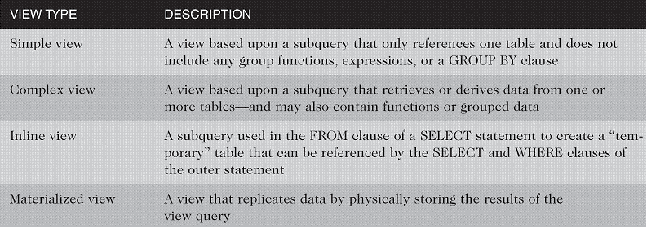
Types of Views
©2016. Cengage Learning. All rights reserved.

Slide 7
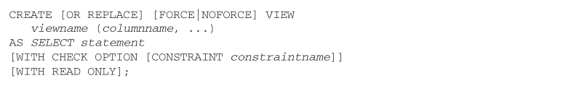
Creating a View
You use the CREATE VIEW keywords to create a view
Use OR REPLACE if the view already exists
Use FORCE if the underlying table does not exist at the time of creation
Provide new column names if necessary
©2016. Cengage Learning. All rights reserved.

Slide 8
Creating a View (continued)
WITH CHECK OPTION constraint – if used, prevents data changes that will make the data subsequently inaccessible to the view
WITH READ ONLY – prevents DML operations
©2016. Cengage Learning. All rights reserved.

Slide 9

Creating a Simple View
Only references one table – no group functions, GROUP BY clause, or expressions
©2016. Cengage Learning. All rights reserved.

Slide 10
DML Operations on a Simple View
Any DML operations are allowed through simple views unless created with WITH READ ONLY option
DML operations that violate constraints on the underlying table are not allowed
©2016. Cengage Learning. All rights reserved.

Slide 11

Creating a Complex View
A complex view may contain data from multiple tables or data created with the GROUP BY clause, functions, or expressions
Type of DML operations allowed depends on various factors
©2016. Cengage Learning. All rights reserved.

Slide 12
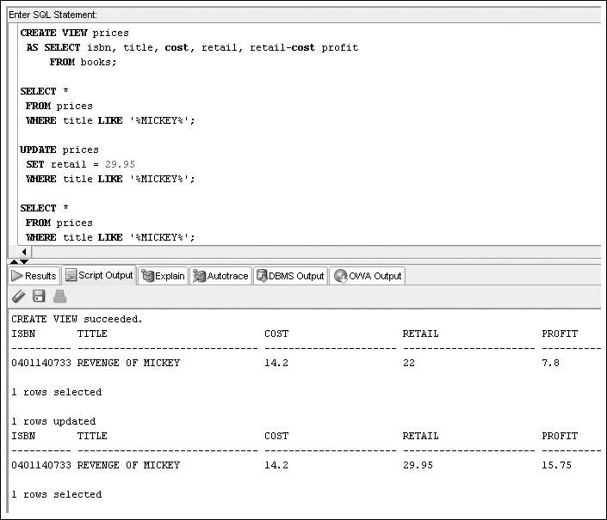
DML Operations on a Complex View with an Arithmetic Expression
©2016. Cengage Learning. All rights reserved.

Slide 13
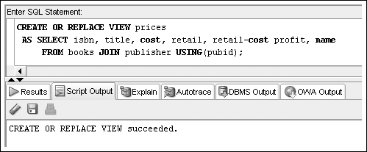
DML Operations on a Complex View Containing Data from Multiple Tables
DML operations cannot be performed on non-key-preserved tables, but they are permitted on key-preserved tables
©2016. Cengage Learning. All rights reserved.

Slide 14
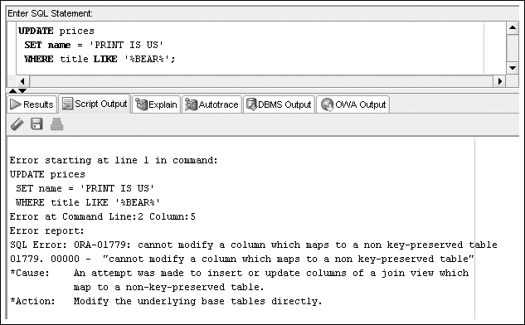
DML Operations on a Complex View Containing Data from Multiple Tables (continued)
©2016. Cengage Learning. All rights reserved.

Slide 15
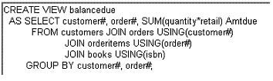
DML Operations on a Complex View Containing Functions or Grouped Data
DML operations are not permitted if the view includes a group function or a GROUP BY clause
©2016. Cengage Learning. All rights reserved.

Slide 16
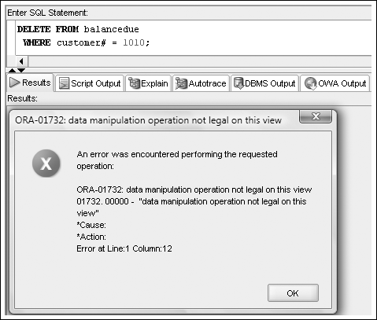
DML Operations on a Complex View Containing Functions or Grouped Data (continued)
©2016. Cengage Learning. All rights reserved.

Slide 17
DML Operations on a Complex View Containing DISTINCT or ROWNUM
DML operations on a view that contains the DISTINCT keyword or ROWNUM are not permitted
©2016. Cengage Learning. All rights reserved.

Slide 18
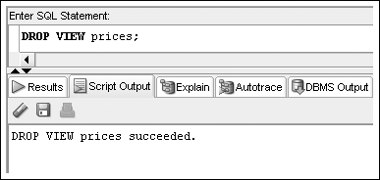
Dropping a View
Use DROP VIEW command
©2016. Cengage Learning. All rights reserved.

Slide 19
Creating an Inline View
An inline view is a temporary table created by using a subquery in the FROM clause
It can only be referenced while the command is being executed
Most common usage – “TOP-N” analysis
©2016. Cengage Learning. All rights reserved.

Slide 20
“TOP-N” Analysis
ORDER BY included to identify top values:
  Descending for highest values
  Ascending for lowest values
Extract data based on ROWNUM
©2016. Cengage Learning. All rights reserved.

Slide 21
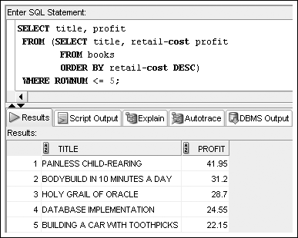
“TOP-N” Analysis (continued)
©2016. Cengage Learning. All rights reserved.

Slide 22
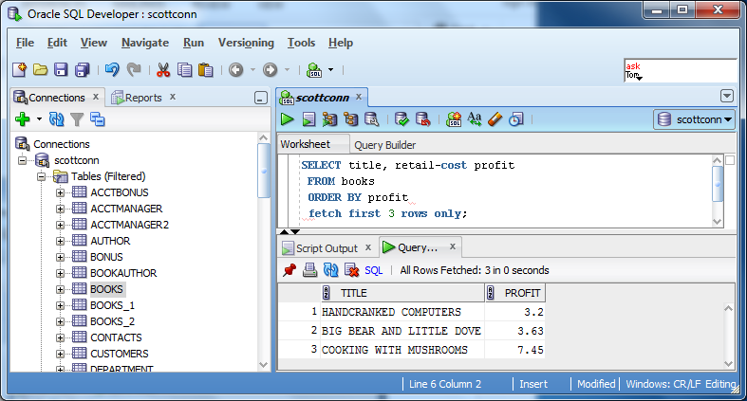
“TOP-N” Analysis (continued)
Oracle 12c introduces a new row limiting clause (# rows)
©2016. Cengage Learning. All rights reserved.

Slide 23
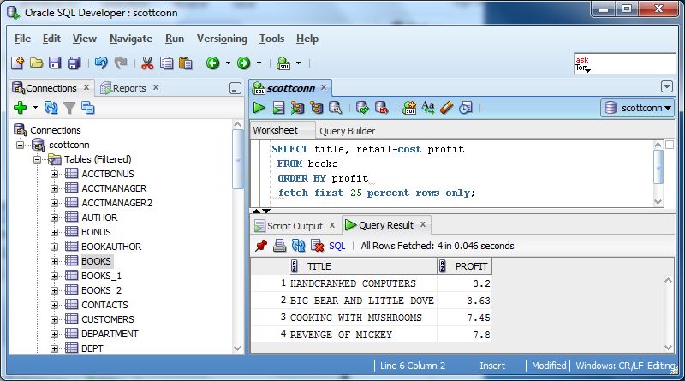
“TOP-N” Analysis (continued)
Oracle 12c introduces a new row limiting clause (percent of rows)
©2016. Cengage Learning. All rights reserved.

Slide 24
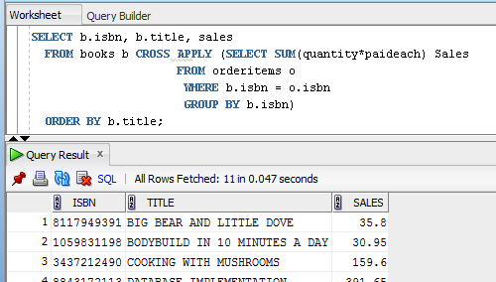
Cross & Outer Apply Joins
A column of the joining table may be used to produce the result set of the inline view
©2016. Cengage Learning. All rights reserved.

Slide 25
Materialized Views
Replicate data
Store data retrieved from view query
Referred to as “snapshots”
©2016. Cengage Learning. All rights reserved.

Slide 26
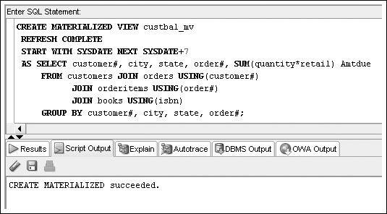
Materialized Views (continued)
©2016. Cengage Learning. All rights reserved.

Slide 27
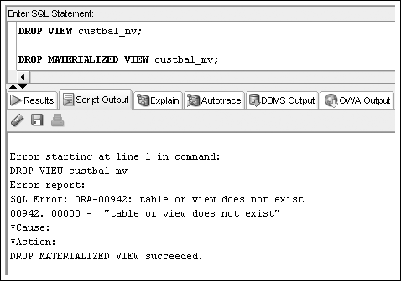
Materialized Views (continued)
©2016. Cengage Learning. All rights reserved.

Slide 28
Summary
A view is a temporary or virtual table that is used to retrieve data that exists in the underlying database tables
The view query must be executed each time the view is used
A view can be used to simplify queries or to restrict access to sensitive data
A view is created with the CREATE VIEW command
A view cannot be modified; to change a view, it must be dropped and then re-created, or the CREATE OR REPLACE VIEW command must be used
©2016. Cengage Learning. All rights reserved.

Slide 29
Summary (continued)
Any DML operation can be performed on a simple query if it does not violate a constraint
A view that contains expressions or functions, or that joins multiple tables, is considered a complex view
A complex view can be used to update only one table; the table must be a key-preserved table
Data cannot be added to a view column that contains an expression
DML operations are not permitted on non-key-preserved tables
©2016. Cengage Learning. All rights reserved.

Slide 30
Summary (continued)
DML operations are not permitted on views that include group functions, a GROUP BY clause, the ROWNUM pseudocolumn, or the DISTINCT keyword
Oracle 12c assigns a row number to every row in a table to indicate its position in the table; the row number can be referenced by the keyword ROWNUM
A view can be dropped with the DROPVIEW command; the data is not affected, because it exists in the original tables
An inline view can be used only by the current statement and can include an ORDER BY clause
“TOP-N” analysis uses the row number of sorted data to determine a range of top values
Materialized views physically store view query results
©2016. Cengage Learning. All rights reserved.

